Slide 1
Exploring the Next Generation Digital Learning Environment
Dr. Charles Severance
University of Michigan School of Information
www.tsugi.org www.koseu.org

Slide 2
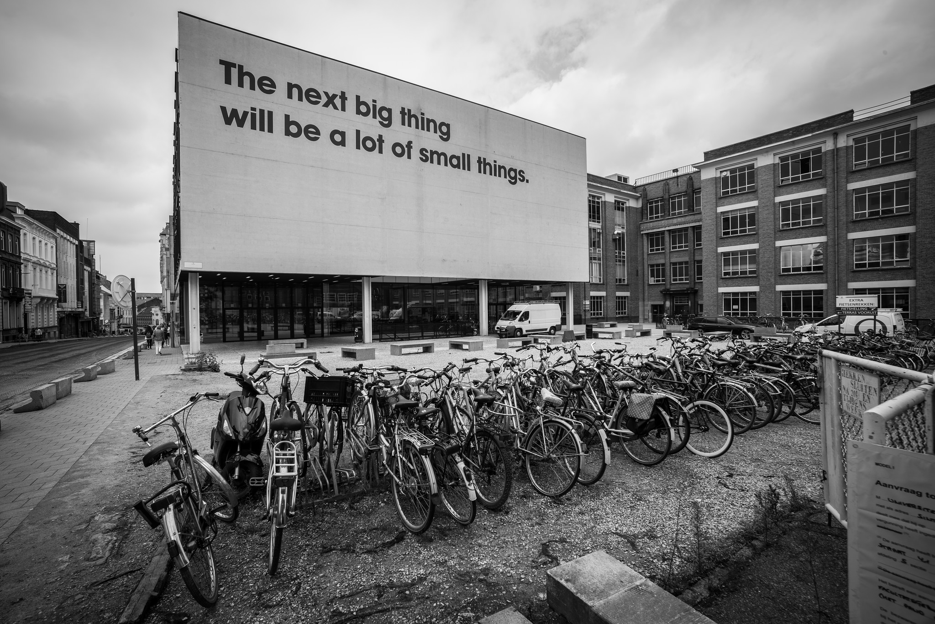
Source: Ian Dolphin

Slide 3
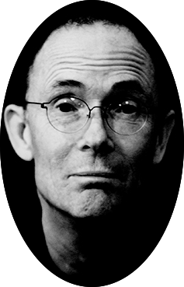
The future is already here — it's just not very evenly distributed.
- William Gibson
https://en.wikiquote.org/wiki/William_Gibson

Slide 4
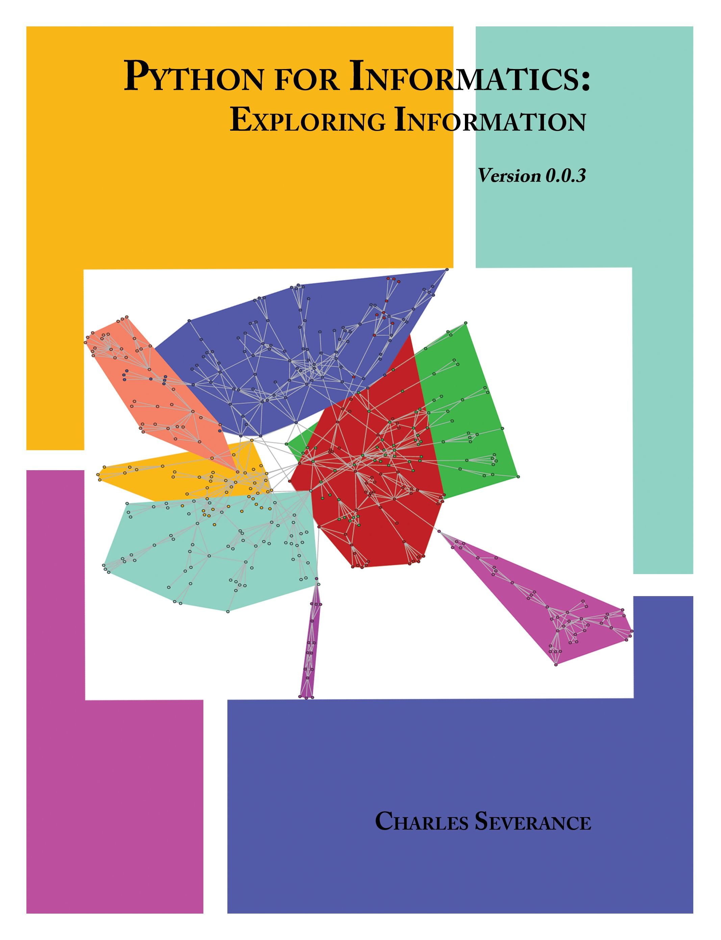
umich.edu
Sakai
Piazza
300
open.umich.edu (drupal)
2
Circa 2012
Notes:
Common Cartridge 2008 / 2011
Learning Tools Interoperability 2011
Content Item 2016

Slide 5
umich.edu
Other Schools / Teachers
Sakai
Moodle
Canvas
Blackboard
Schoology
…
300
15
Sakai
Canvas
1.3M
Coursera
Apps (次)
Content (코스)
EdX
github
3K
Cloudflare
archive.org
py4e.com
Apps (次)
Content (코스)
Amazon
Prime Video
Amazon
CreateSpace
iTunes
YouTube
6K
456K
Circa 2016
Notes:
Common Cartridge 2008 / 2011
Learning Tools Interoperability 2011
Content Item 2016

Slide 6
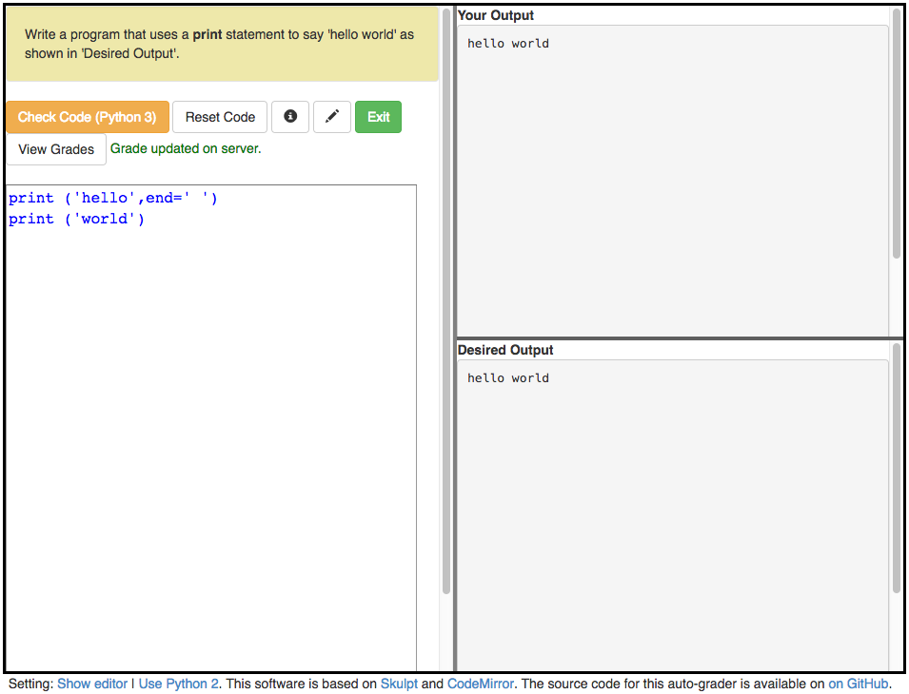
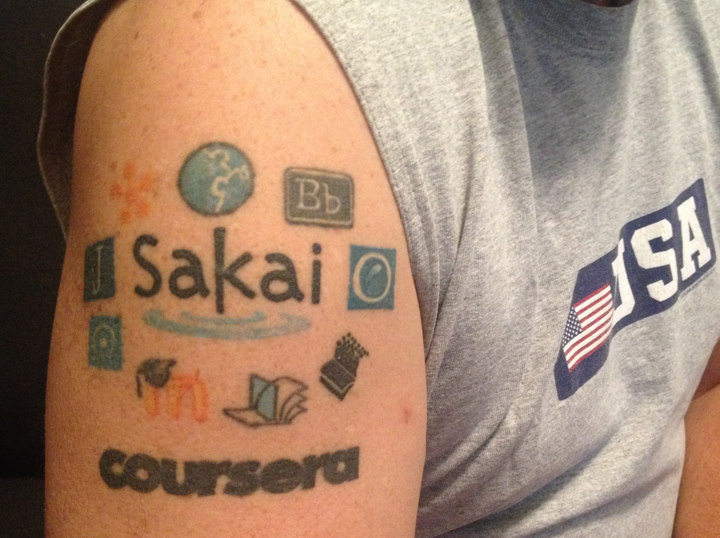
WHAT HAPPENNED?

Slide 7
CONTENT ITEM®
CC®
LTI®
IMS CONTENT ITEM® FILLS THE GAPS AND MAKES CONNECTIONS BETWEEN IMS LEARNING TOOLS INTEROPERABILITY® AND IMS COMMON CARTRIDGE®.
LTI®, CC®, and Content Item® are trademarks of IMS Global Learning Consortium, Inc. (www.imsglobal.org)

Slide 8
CONTENT ITEM®
CC®
LTI®
FOR THE FIRST TIME IN THE HISTORY OF EDUCATIONAL TECHNOLOGY, YOU CAN MAKE AN APP STORE OR LEARNING OBJECT REPOSITORY WITHOUT PROPRIETATY EXTENSIONS.
LTI®, CC®, and Content Item® are trademarks of IMS Global Learning Consortium, Inc. (www.imsglobal.org)

Slide 9
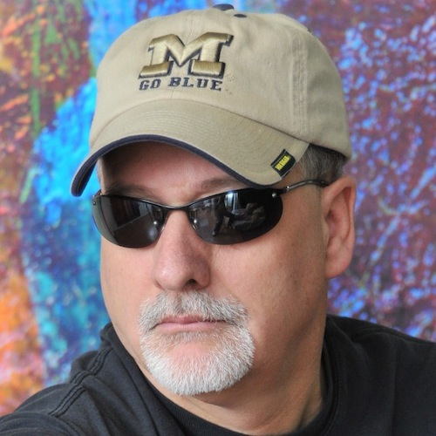
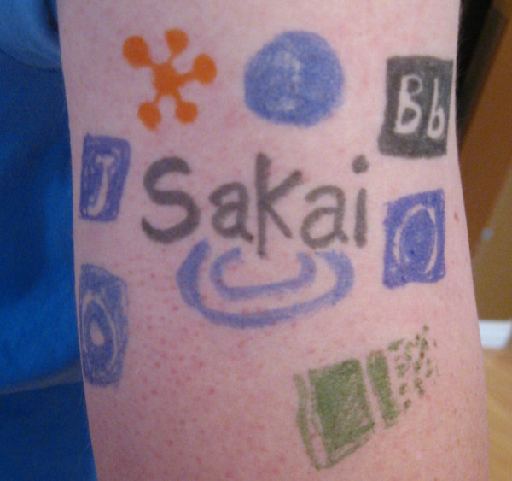
@drchuck
@whitmer
@brackenm

Slide 11
Topics
Educational App Store
API Libraries
"Lego Blocks"
Interoperability
New tools that *teach*
EdTech startups made easy
Training / Documentation
Enrich Open Educational Content
Seamless Content Integration and Reuse (LOR)
Stand-Alone MOOC platform
LMS based on Tsugi technology
koseu.org (코스)

Slide 12
Demo

Slide 13
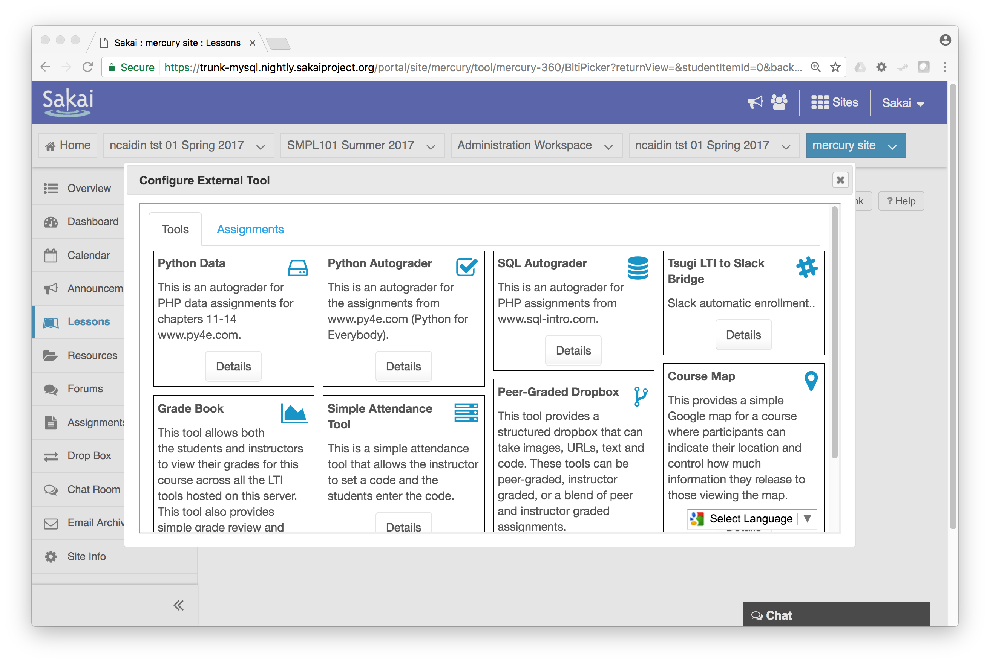

Slide 14
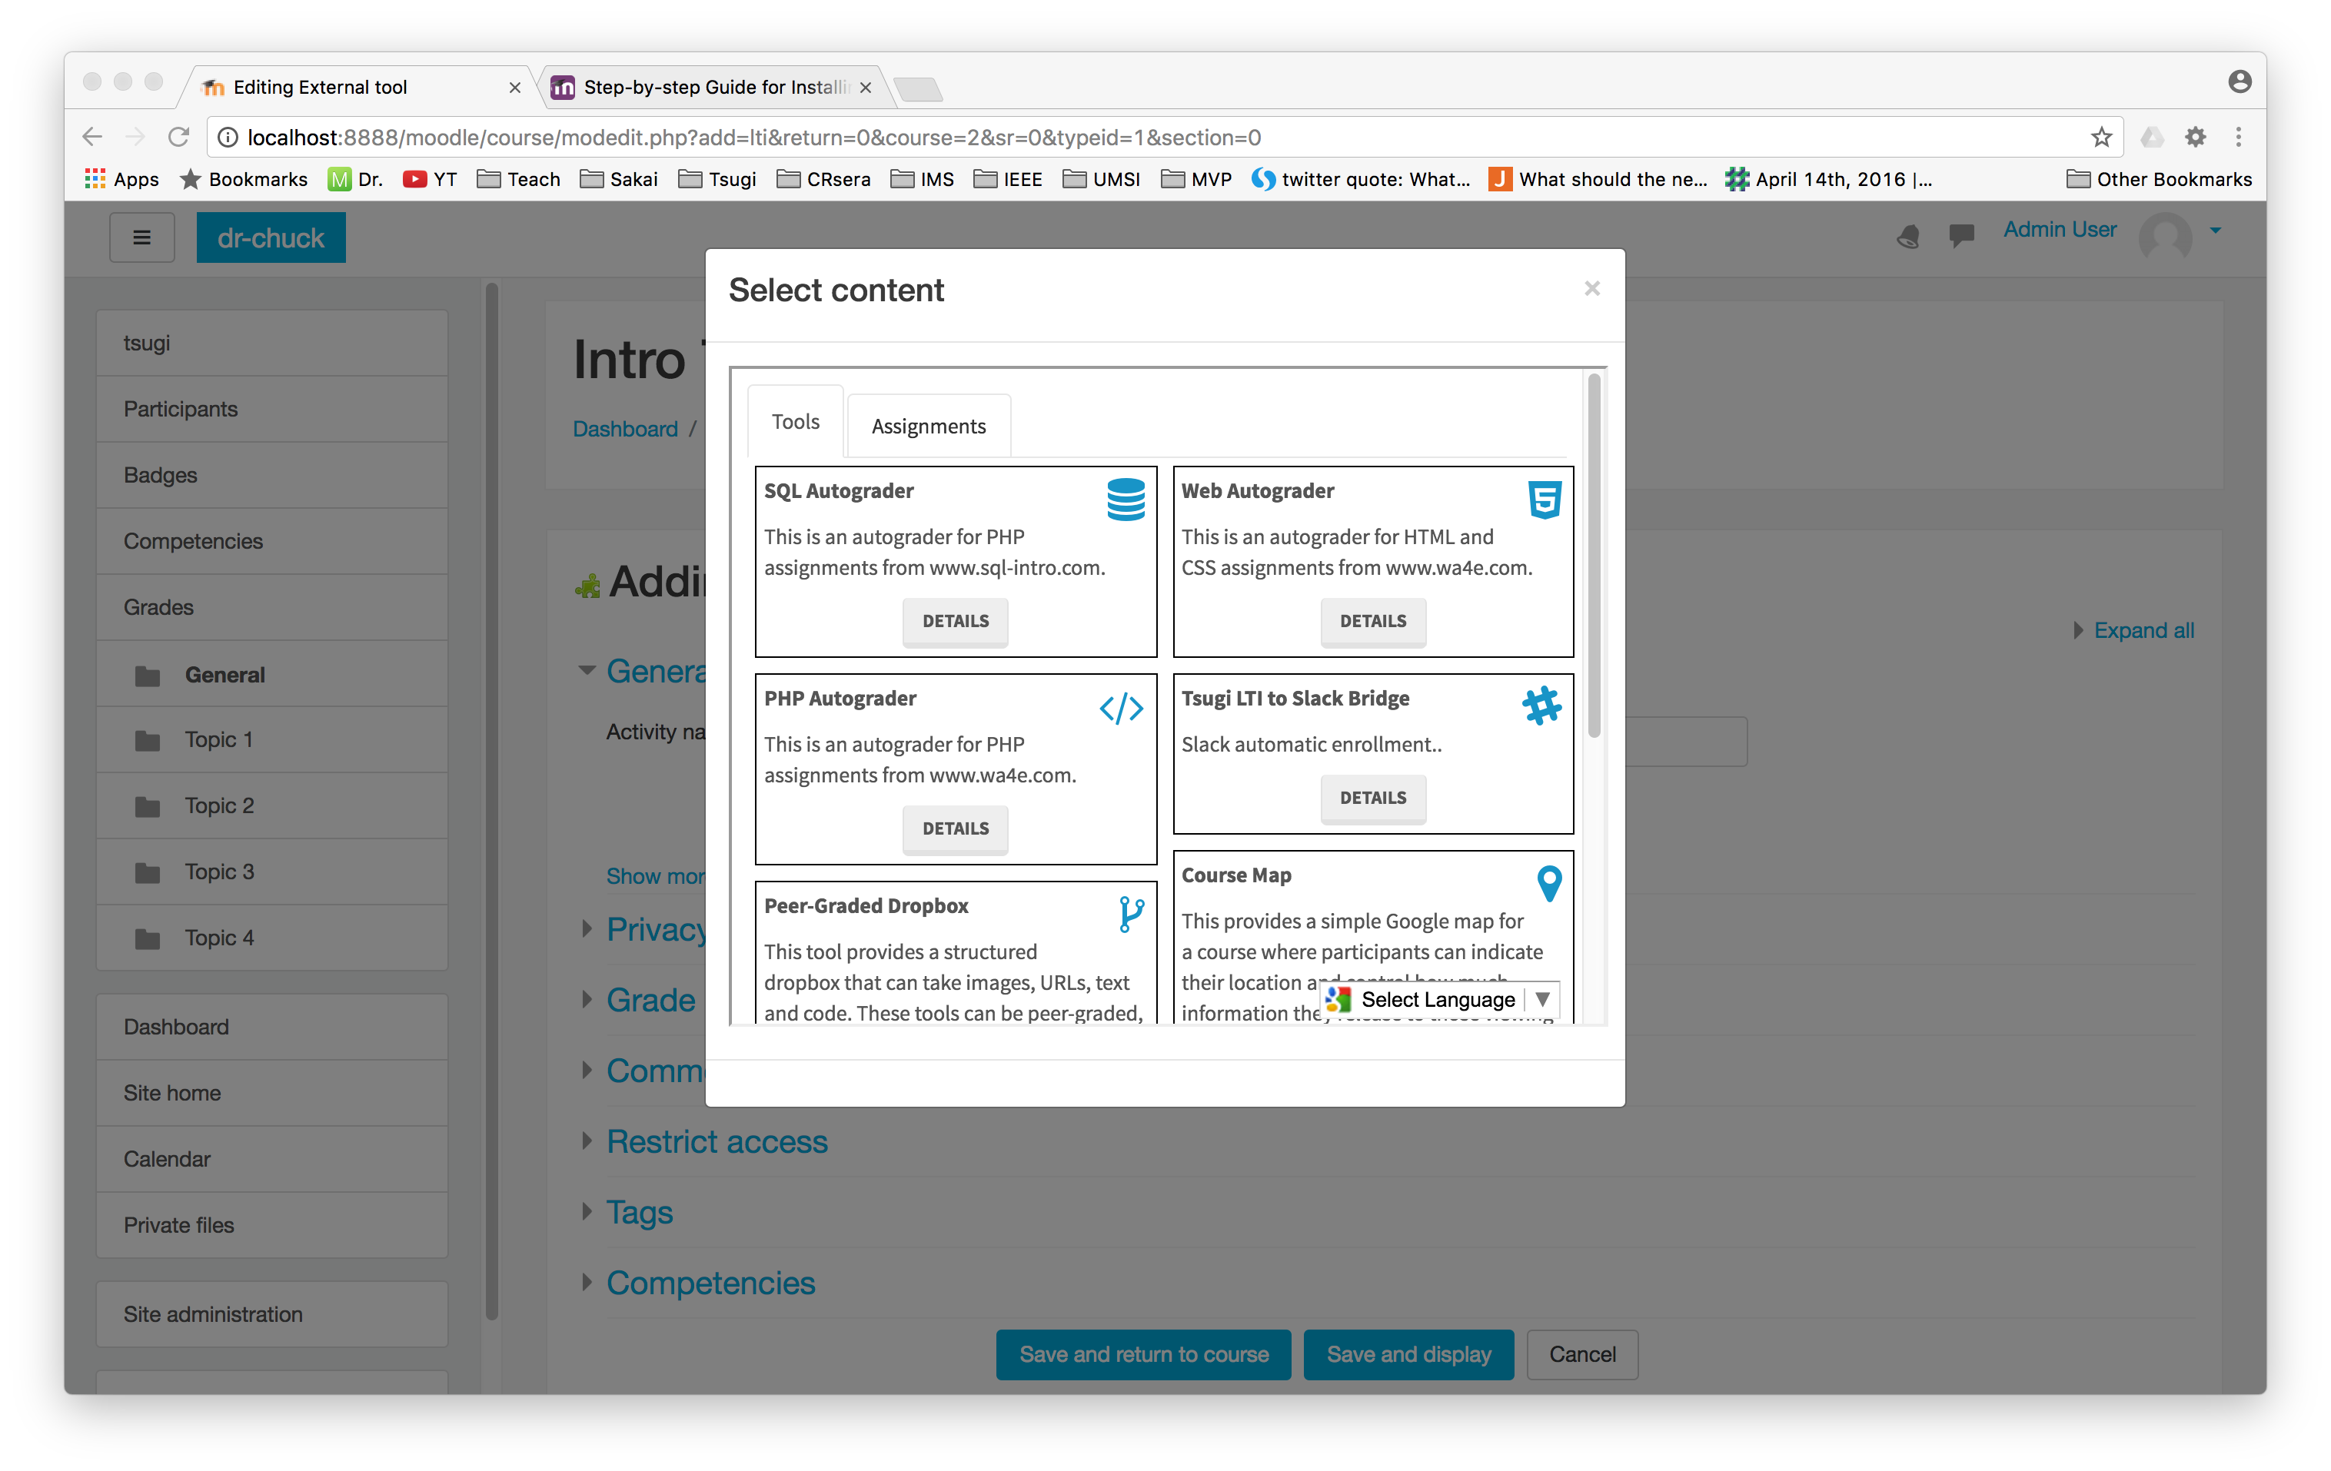

Slide 15
Any Questions? www.tsugi.org www.py4e.com www.wa4e.com

